Slide 1
Chapter 1
Getting Started with Dreamweaver

Slide 2
Chapter 1 Lessons
Explore the Dreamweaver workspace
View a web page and use Help
Plan and define a website
Add a folder and pages
© 2010 Delmar Cengage Learning

Slide 3
Getting Started with Dreamweaver
What is Dreamweaver?
  Web design software for creating a web page or a complex website
What is a website?
  A group of related web pages that are linked together and share a common interface and design
© 2010 Delmar Cengage Learning

Slide 4
Using Dreamweaver Tools
What does Dreamweaver CS4 offer?
  Design tools that can create dynamic and interactive web page without writing HTML code
  Organizational tools
  Site management tools
  Graphic site maps
© 2010 Delmar Cengage Learning

Slide 5
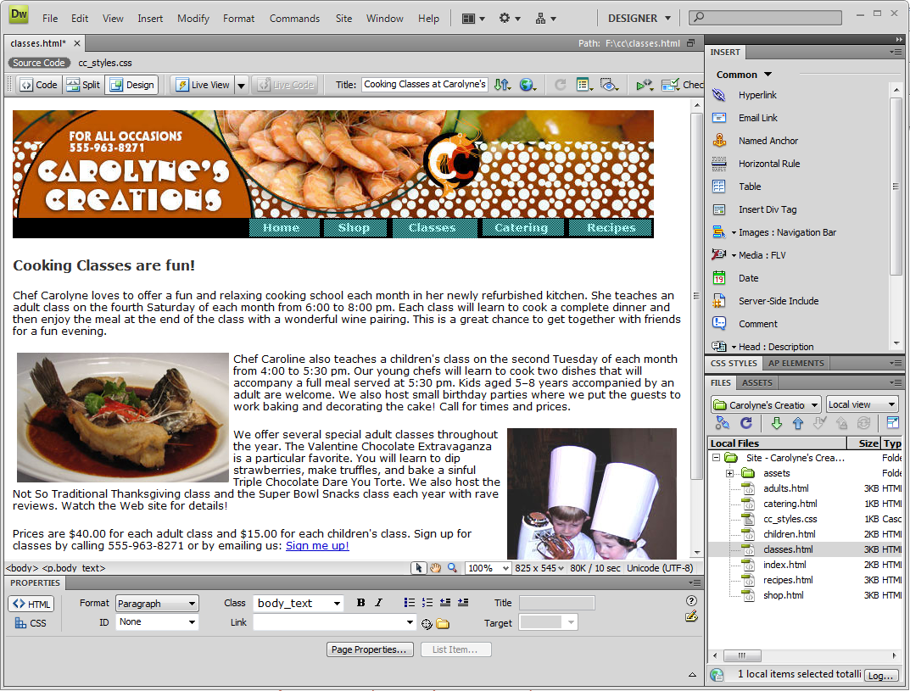
Fig 1: Dreamweaver CS4 Workspace
Workspace switcher
Application bar (Win) or Menu bar (Mac)
Insert panel
Related files toolbar
Document border
Drag the panel border up or down to resize insert panel
Document window
Tag selector
Property inspector
Select tool
Hand
tool
Zoom tool
Files panel
© 2010 Delmar Cengage Learning

Slide 6
Working with Dreamweaver Views
Design view
Code view
Code and Design view
© 2010 Delmar Cengage Learning

Slide 7
Starting Dreamweaver: Windows
Click the Start button on the taskbar
Point to All Programs, click Adobe Web Premium CS4, then click Adobe Dreamweaver CS4
© 2010 Delmar Cengage Learning

Slide 8
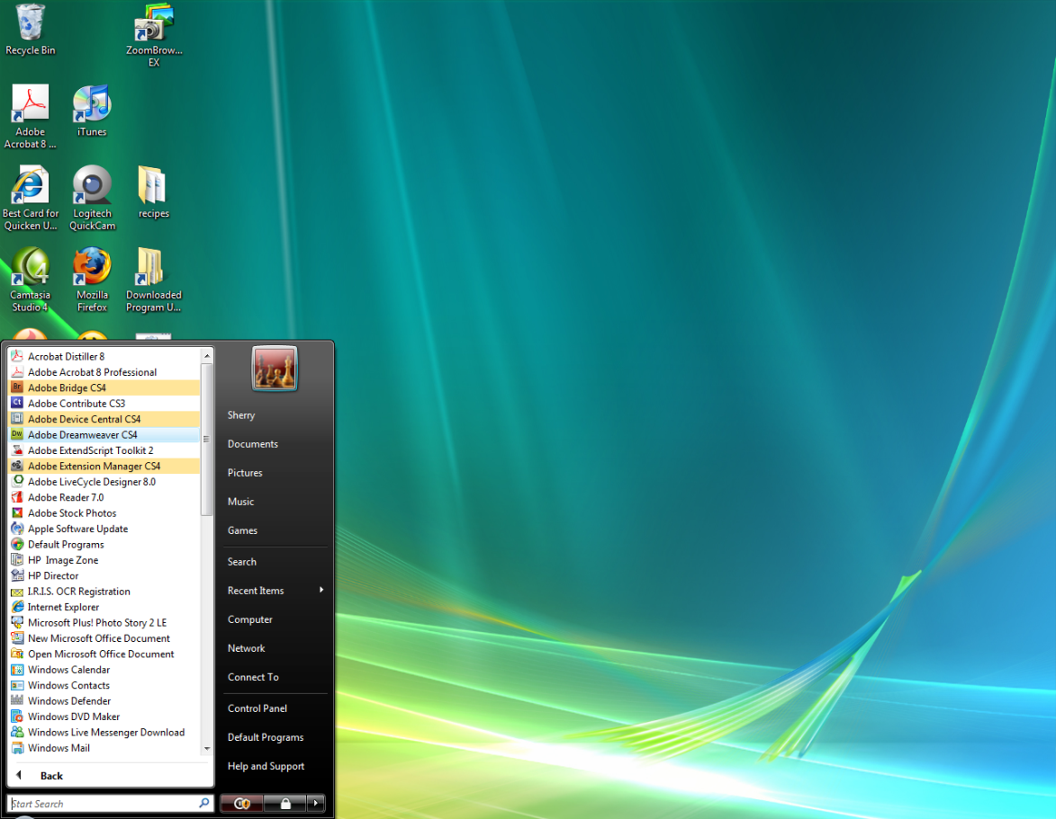
Figure 3: Starting Dreamweaver CS4
Click Adobe Dreamweaver CS4
© 2010 Delmar Cengage Learning

Slide 9
Starting Dreamweaver: (Macintosh)
Click Finder in the Dock, then click Applications
Click the Adobe Dreamweaver CS4 folder, then double-click the Dreamweaver CS4 application
© 2010 Delmar Cengage Learning

Slide 10
Changing Views
Click the Show Code View button
Click the Show Code and Design Views button
Click the Show Design View button
© 2010 Delmar Cengage Learning

Slide 11
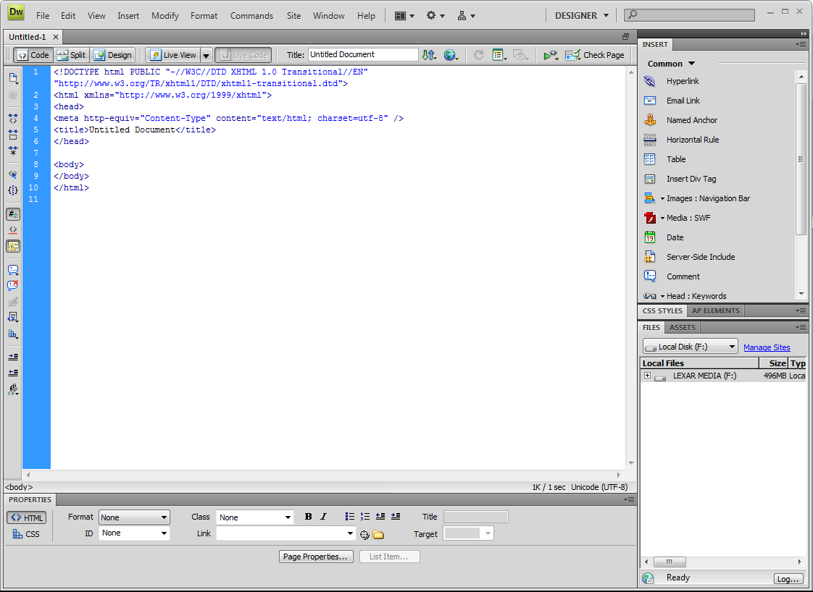
Figure 5: Code View for
New Document
Show Code and Design view button
Show Design view button
Switch Design View
to Live View button
Show Code view button
Coding toolbar
Some options may differ depending on what was last selected
Click to collapse all panels to icons
© 2010 Delmar Cengage Learning

Slide 12
Opening a Web Page
Create new or open existing
  Website
  Web page
Homepage
  First web page that appears when viewers go to a website
  Sets the look and feel of the website and directs viewers to the rest of the pages in the website
© 2010 Delmar Cengage Learning

Slide 13
Basic Web Page Elements
Text
Hyperlinks (links)
Graphics
  Banners
Navigation bars
  Image map
Flash button objects
© 2010 Delmar Cengage Learning

Slide 14
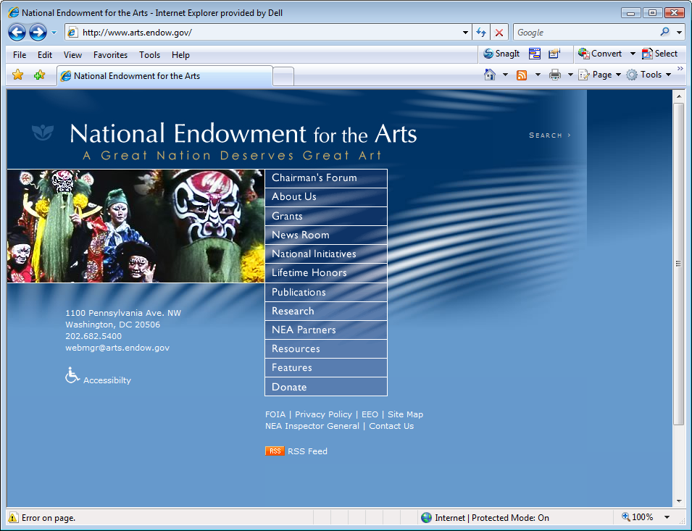
Fig. 8: Common Web Page Elements
Banner with logo
Search feature
Image
Link to main pages in the website
Contact information
Links to support pages
National Endowment for the Arts website – www.arts.endow.gov
© 2010 Delmar Cengage Learning

Slide 15
Using Dreamweaver Help
Clicking the Dreamweaver Help command opens the Dreamweaver Help page that contains a list of topics and subtopics by category
© 2010 Delmar Cengage Learning

Slide 16
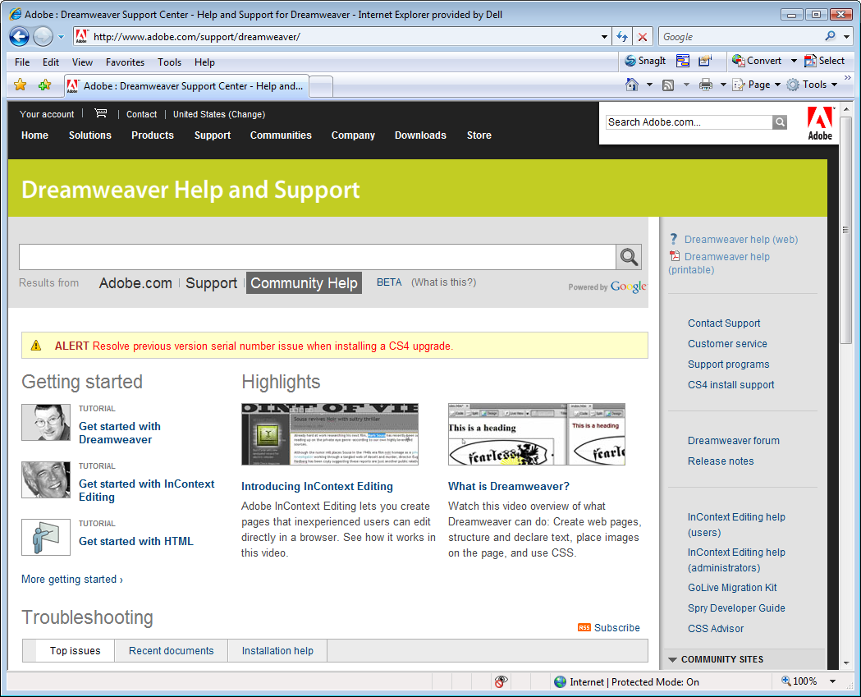
Fig. 10: Dreamweaver Help and Support Web Page
Dreamweaver help (web) link
© 2010 Delmar Cengage Learning

Slide 17
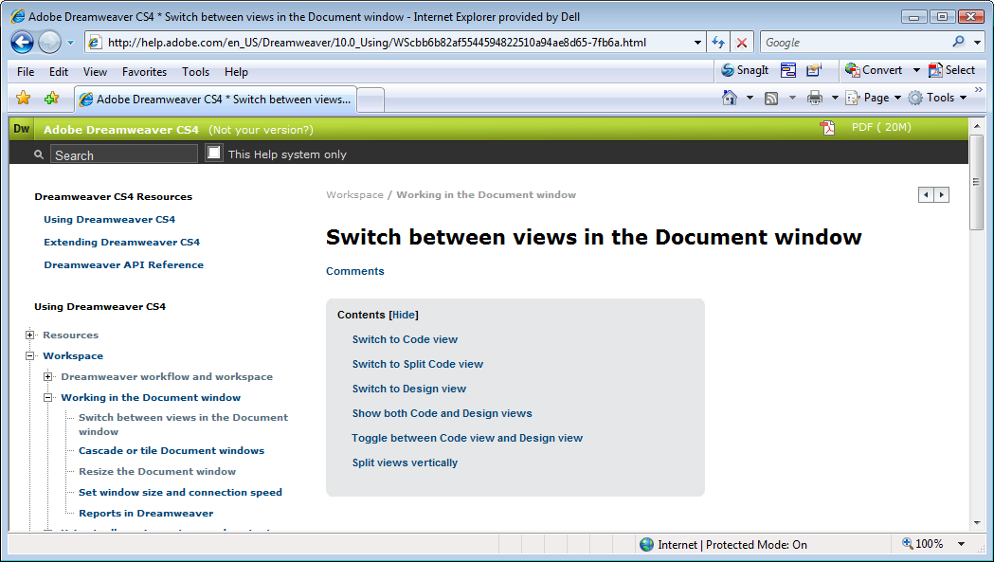
Fig. 11: Displaying Help Content
Selected subtopic content opens on right side of Help window
Click plus sign to expand menu of Help topics
© 2010 Delmar Cengage Learning

Slide 18
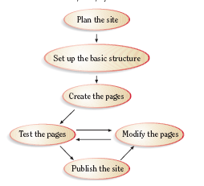
Fig. 13: Phases of a Website
Development Project
© 2010 Delmar Cengage Learning

Slide 19
Planning a Website
Audience needs
Site goals
Gathering content
Budget
Schedule
Team
Updates
© 2010 Delmar Cengage Learning

Slide 20
Setting Up the Basic Structure
Storyboard is a small sketch that represents each page
Allow you to visualize how each page is linked to one another
  Parent pages: home page
  Child pages: pages linked below it
Contains root folders and assets
© 2010 Delmar Cengage Learning

Slide 21
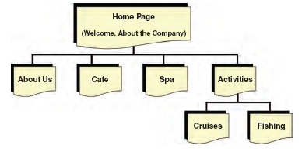
Fig. 14: Striped Umbrella Website Storyboard
© 2010 Delmar Cengage Learning

Slide 22
Creating the Web Pages and Collecting the Page Content
Gather the files that will be used
Some will come from other software
Some will be done in Dreamweaver
© 2010 Delmar Cengage Learning

Slide 23
Testing the Pages
Browsers and browser versions
Screen sizes
Connection download time
Testing is a continuous process
© 2010 Delmar Cengage Learning

Slide 24
Modifying the Pages
Changes are constantly needed
Test page after each change
Modifying and testing is an ongoing process
© 2010 Delmar Cengage Learning

Slide 25
Publishing the Site
Transfer all the files to a web server
  Web server: a computer that is connected to the Internet with an IP address
A website must be published to the web server before it can be viewed by others
© 2010 Delmar Cengage Learning

Slide 26
Publishing the Site
IP: Internet Protocol
  IP address
  Example: 207.456.123.2
ISP: Internet Service Provider
  Hosts website
FTP: File Transfer Protocol
  Host, host directory, login, password
© 2010 Delmar Cengage Learning

Slide 27
Publishing the Site
Create a root folder
Define the website
Set up web server access
© 2010 Delmar Cengage Learning

Slide 28
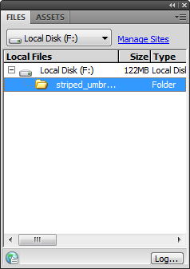
Fig. 16: Creating a Root Folder
Using the Files Panel
Your drive or folder may differ
If you just see a drive or folder name here you do not currently have a website open
Striped_umbrella root folder
© 2010 Delmar Cengage Learning

Slide 29
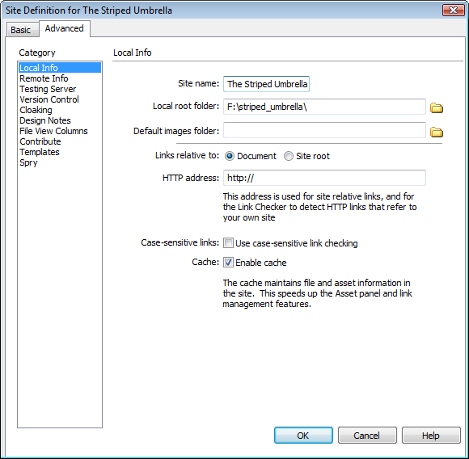
Fig. 18: Site Definition
Striped Umbrella Dialog Box
Advanced tab
Website name
Browse for file icon
Local root folder text box – your drive may differ
Links relative to: option
Enable cache check box
© 2010 Delmar Cengage Learning

Slide 30
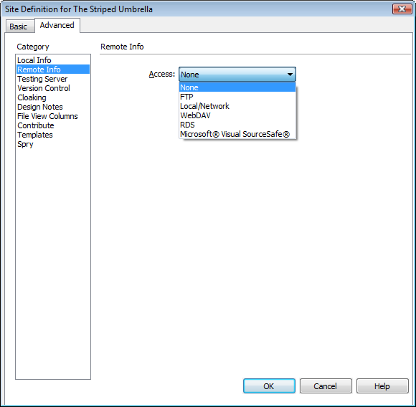
Fig. 19: Setting the Remote Access
Remote Info category
Access pop-up menu
© 2010 Delmar Cengage Learning

Slide 31
Adding a Folder to a Website
After defining a website, you need to create folders to organize the files that will make up the site
You can use the assets folder to store all non-HTML files, such as images or sound files
© 2010 Delmar Cengage Learning

Slide 32
The Assets Folder
Stores all non-HTML (media) files:
  Image files
  Sound files
  Video files
Set it as the default location to store the website images
You might want to create subfolders for each type of file
© 2010 Delmar Cengage Learning

Slide 33
Creating the Home Page
Starting point for a site map
Tells Dreamweaver which page you have designated to be your home page
Usually index.html (.htm), or default.html (.htm)
© 2010 Delmar Cengage Learning

Slide 34
Adding Pages to a Website
Once you add and name pages to your website, you can add content to each page (text and graphics)
You have a choice of several default document types you can generate when you create new HTML pages
XHTML 1.0 Transitional is the default document type when you install Dreamweaver
The default document type is designated in the Preferences dialog box
© 2010 Delmar Cengage Learning

Slide 35
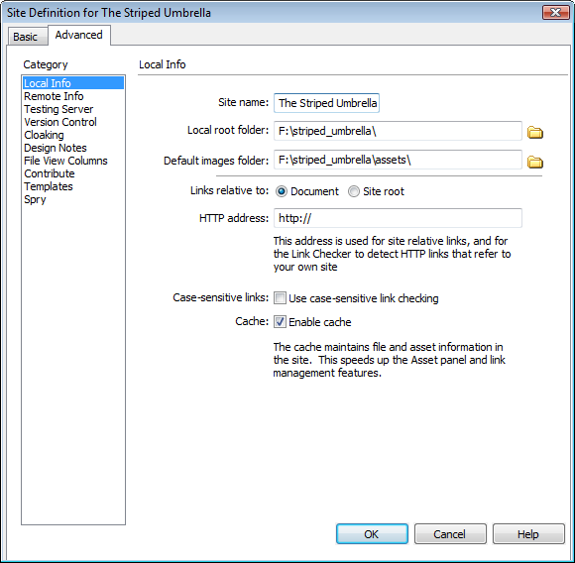
Fig. 22: Site Definition with Assets Folder Set as Default Images Folder
Default images folder text box
Browse for file icon
© 2010 Delmar Cengage Learning

Slide 36
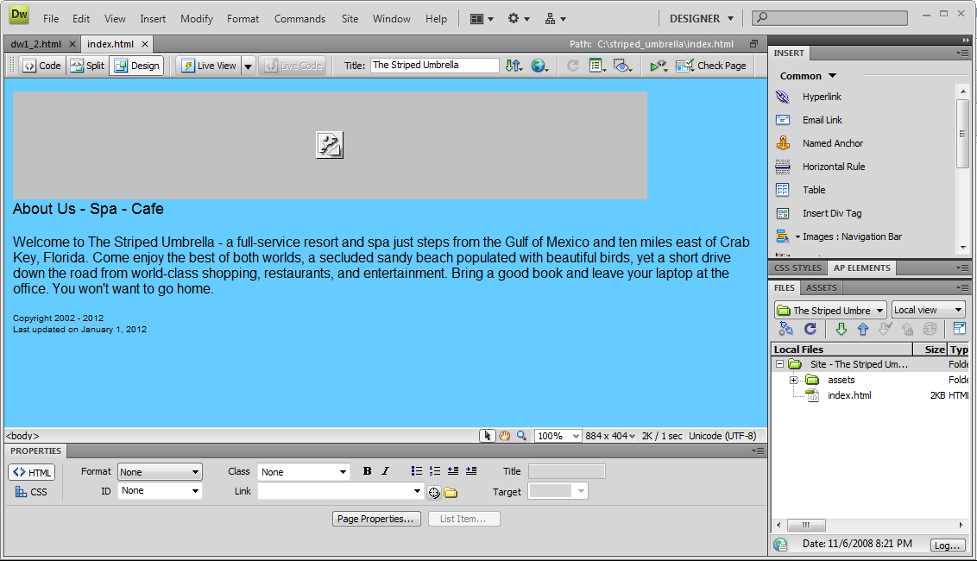
Fig. 23: Index.html Placed in Striped_Umbrella Root Folder
Windows users see the path; Mac users see only the file name and document type
Link to banner is broken because the banner is not yet inside the website
Broken link icon
Root folder
Index.html
© 2010 Delmar Cengage Learning

